Slide 1


Remove drop down from “Our App”
Headers must be in pure white colour
Whenever cursor goes on these sections then it must change colour to our theme
Whenever cursor goes on Logo color effect from down to upside
Change font of THE MEWA (Thoda patla joie)

Slide 2
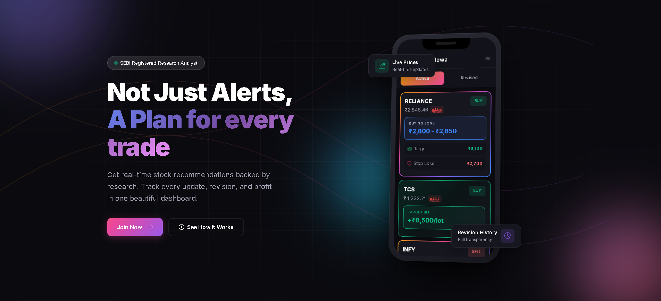
Border colour of our theme
We’ll Provide You
Buy & Sell Alerts
With
Target & Stop Loss
Track every
Active Recommendation
Revised Recommendation
In our App / Website
Revision History to Revised.
It must be placed next to Revised Tab on top & move horizontally.
Same for from Live Prices to Active.
Font colour of our theme
Background complete black #000000

Slide 3
Background in White Colour
Slightly bigger than this
“THE MEWA” A product of “Equamatrix Advisors Pvt Ltd” * SEBI Reg No: INH0000XXXXX
“ * “ Aa star vache avo joie

Slide 4

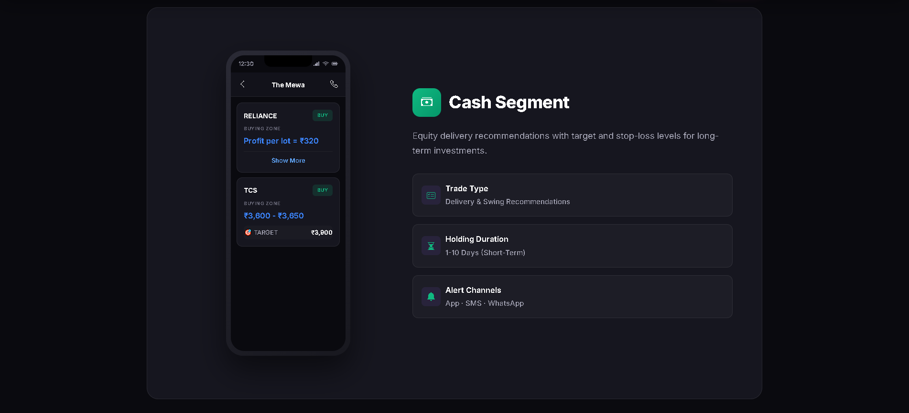
Font colour Black & border as per our theme & slightly bigger in size.
“Our services” na button nu background in White.
slightly smaller in size
Remove this line
Card in White Colour
Mobile size smaller
Screen shot same as our app with Cash Segment Highlighted
Equity segment recommendations with target and stop-loss levels
Intraday, Delivery & Swing Recommendation
0 – 20 Days (Short Term)
App - Website
This full must be in one section only

Slide 5
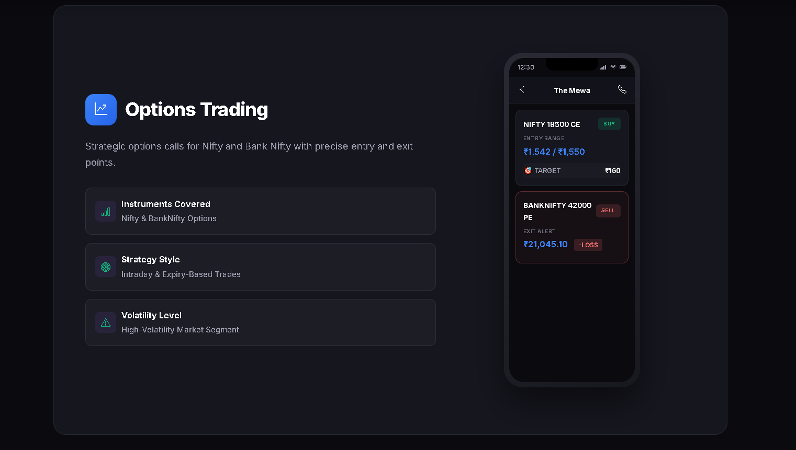
Card in White Colour
Strategic options calls for Index Options & Stocks Options with entry and exit points.
Mobile size smaller
Screen shot same as our app with Options Segment Highlighted
Index Options & Stock Options
Intraday & Positional Recommendations
Risk Management
Pre-defined Target & Stop-Loss
This full must be in one section only

Slide 6
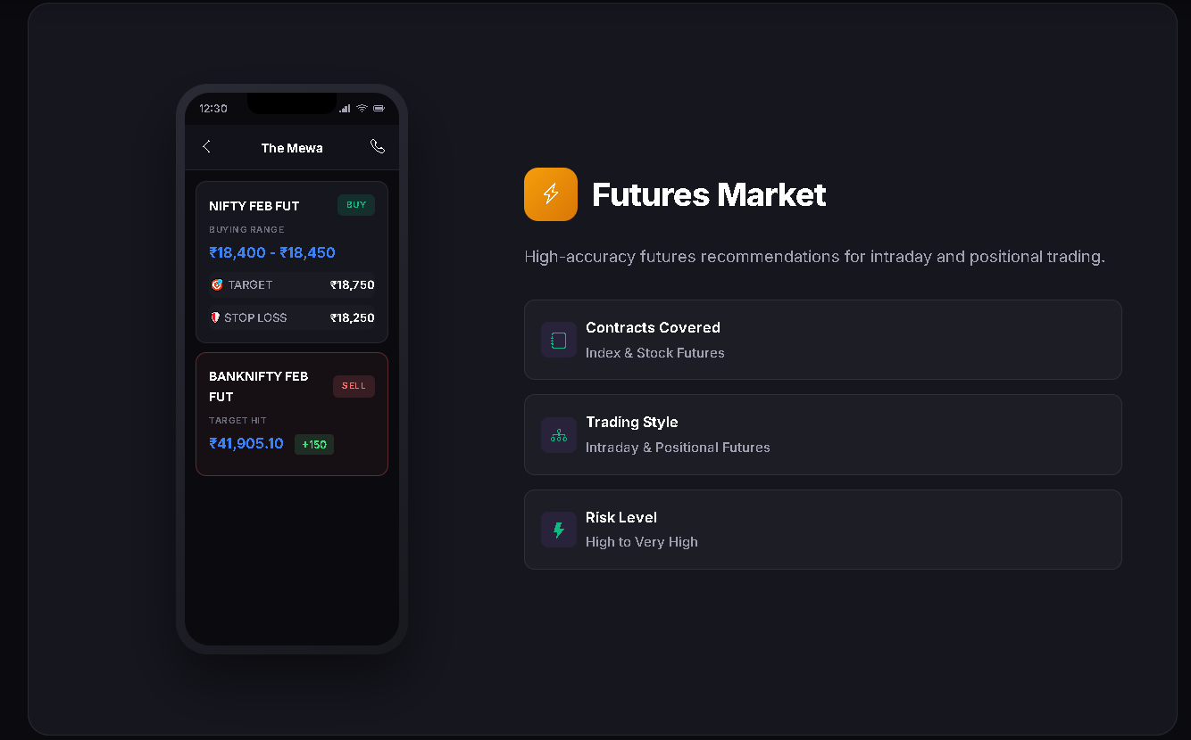
Card in White Colour
Mobile size smaller
Screen shot same as our app with Futures Segment Highlighted
Futures recommendations for intraday and positional trading.
Recommendation Management Get clear Entry, Target, and Stop Loss
This full must be in one section only

Slide 7
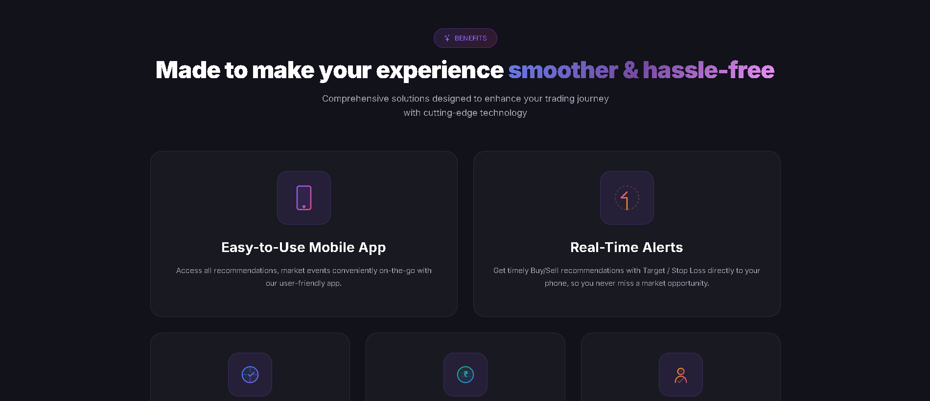
Font colour Black & border as per our theme & slightly bigger in size.
“Benefits” na button nu background in White.
slightly smaller in size
Remove this line

Slide 8


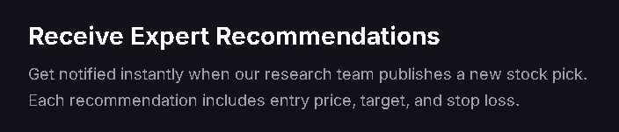
White background in this section.
Font colour White & border as per our theme & slightly bigger in size.
“Get Started” na button nu background in Black.
Start Getting Recommendations in 3 Simple Steps
Use our theme colour in “3 Simple Steps”
Join / Login in “THE MEWA” App & Website.
Become a member of THE MEWA Family

Slide 9
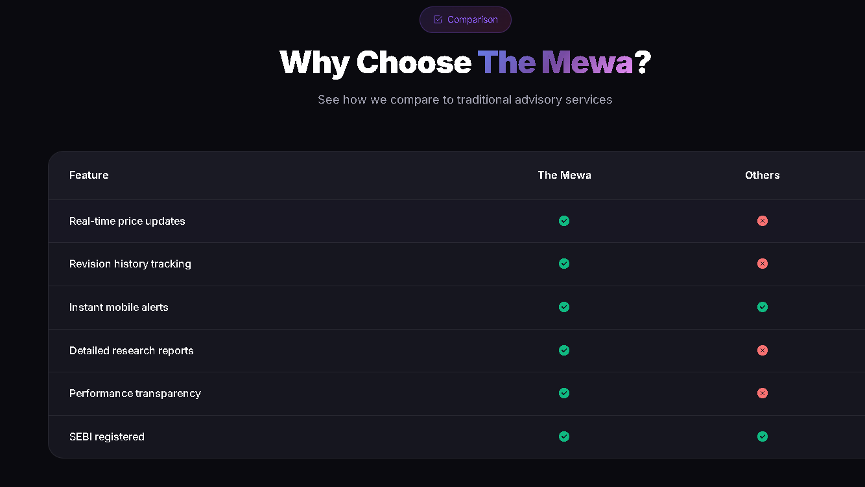
Remove this line
Remove this line
Remove this line

Slide 10
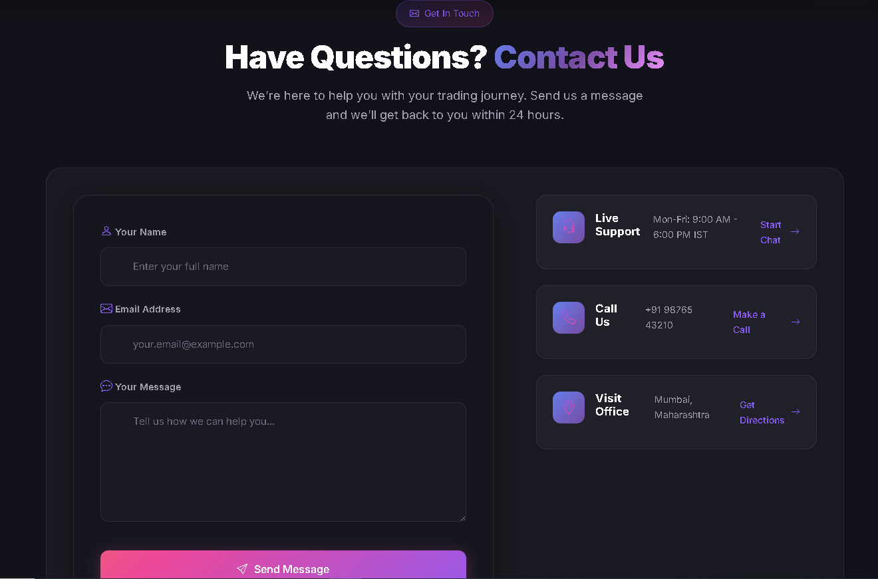
White background in this section.
Font colour Black & border as per our theme & slightly bigger in size.
“Get In Touch” na button nu background in White.
We’re Happy to help you.
Send us a message and we'll get back to you.
Add Mobile no section also
Remove Visit Office & Live support.
Only Call, Whatsapp & E-mail

Slide 11

Delete this section from all pages

Slide 12
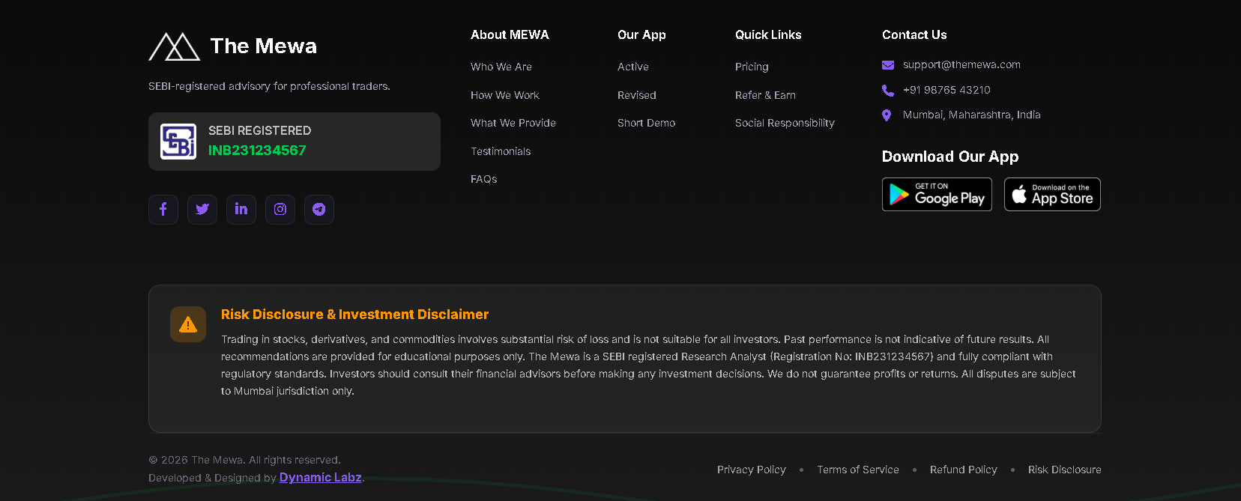

Slide 13
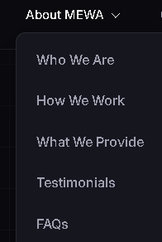
About Mewa
Section starts here.
Dorp down as it is.

Slide 14

Font colour Black & border as per our theme & slightly bigger in size.
“Get In Touch” na button nu background in White.
Background in complete black colour.
And remove colouring spots

Slide 15

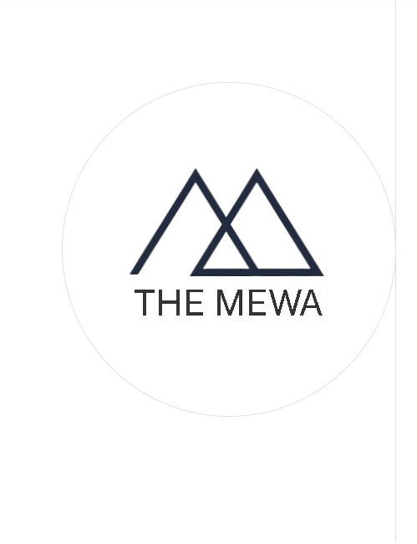
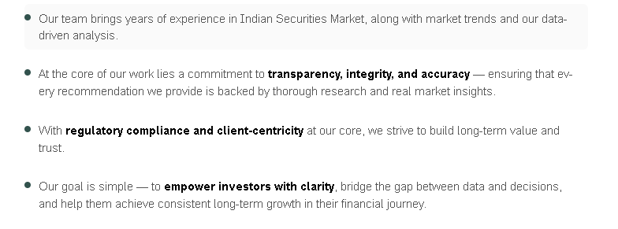
White background in this section.
Font colour White & border as per our theme & slightly bigger in size.
“Who We Are” na button nu background in Black.
We are a SEBI-registered Research Analyst firm with deep-rooted expertise.
Border of circle & straight line in our theme colour

Slide 16
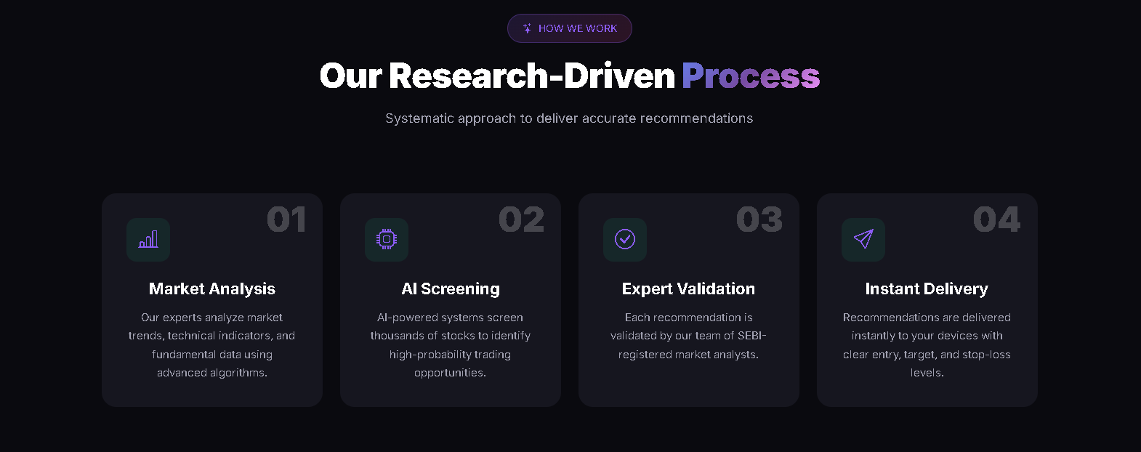
Font colour Black & border as per our theme & slightly bigger in size.
“Get In Touch” na button nu background in White.
Each recommendation is validated by our SEBI-registered market analyst.
When the mouse is on any of the box then effect only once not multiple times.

Slide 17


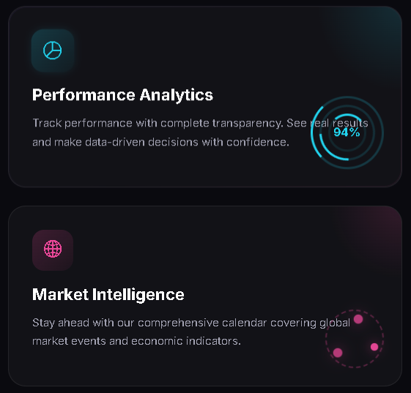

White background in this section.
But the below 4 boxes in Black as it is.
Expert-backed Buy and Sell recommendations with precise Targe and Stop Loss levels. Our analyst combine technical analysis with fundamental research to deliver Recommendations
All Good
Just remove 94% from this and keep design as it is including the colour spots
Should be updated daily and
if + then in Green colour,
if - then in Red colour

Slide 18
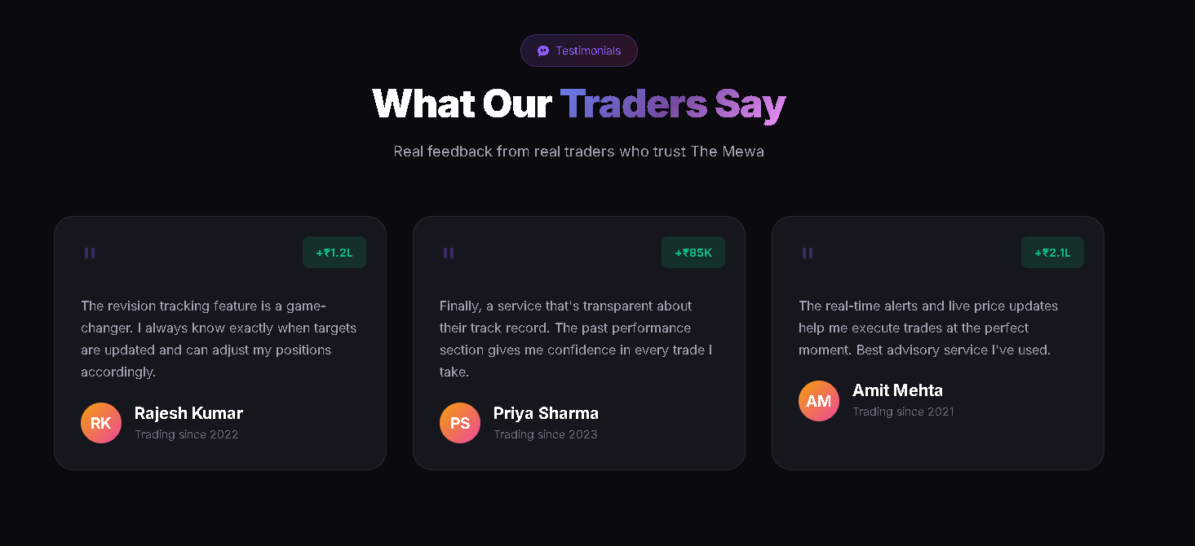
Font colour Black & border as per our theme & slightly bigger in size.
“Testimonials” na button nu background in White.
Building Trust Through Transparency
Remove this

Slide 19
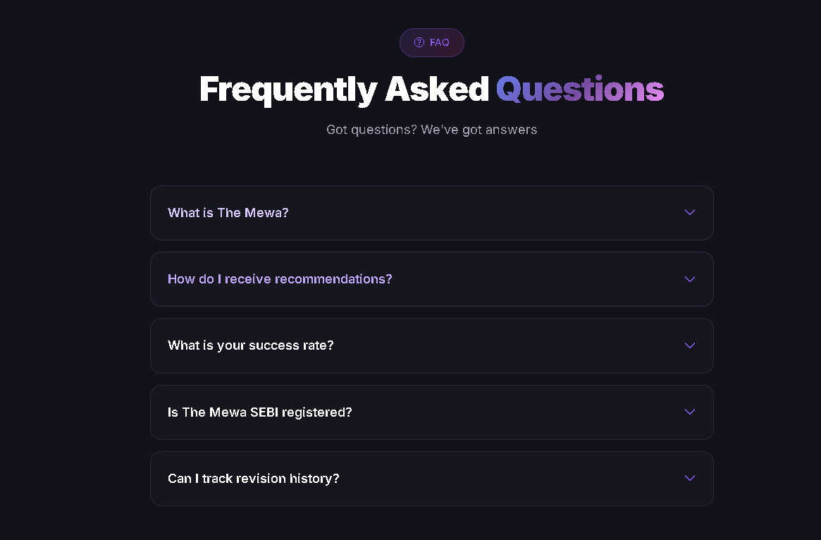
White background in this section.

